Slide 1

INDIAN INSTITUTE OF REMOTE SENSING, DEHRADUN
The effects of Water Stress on Crop Yield and
Yield Estimation using Machine Learning
By:
Rachit Patel
daiict19028
Pradip Patelia
daiict19018
Submitted to:
Dr. N. R. Patel
(Agriculture & Soils Department)
Dr. Prasun Kumar Gupta
(Geo-Informatics Department)

Slide 2
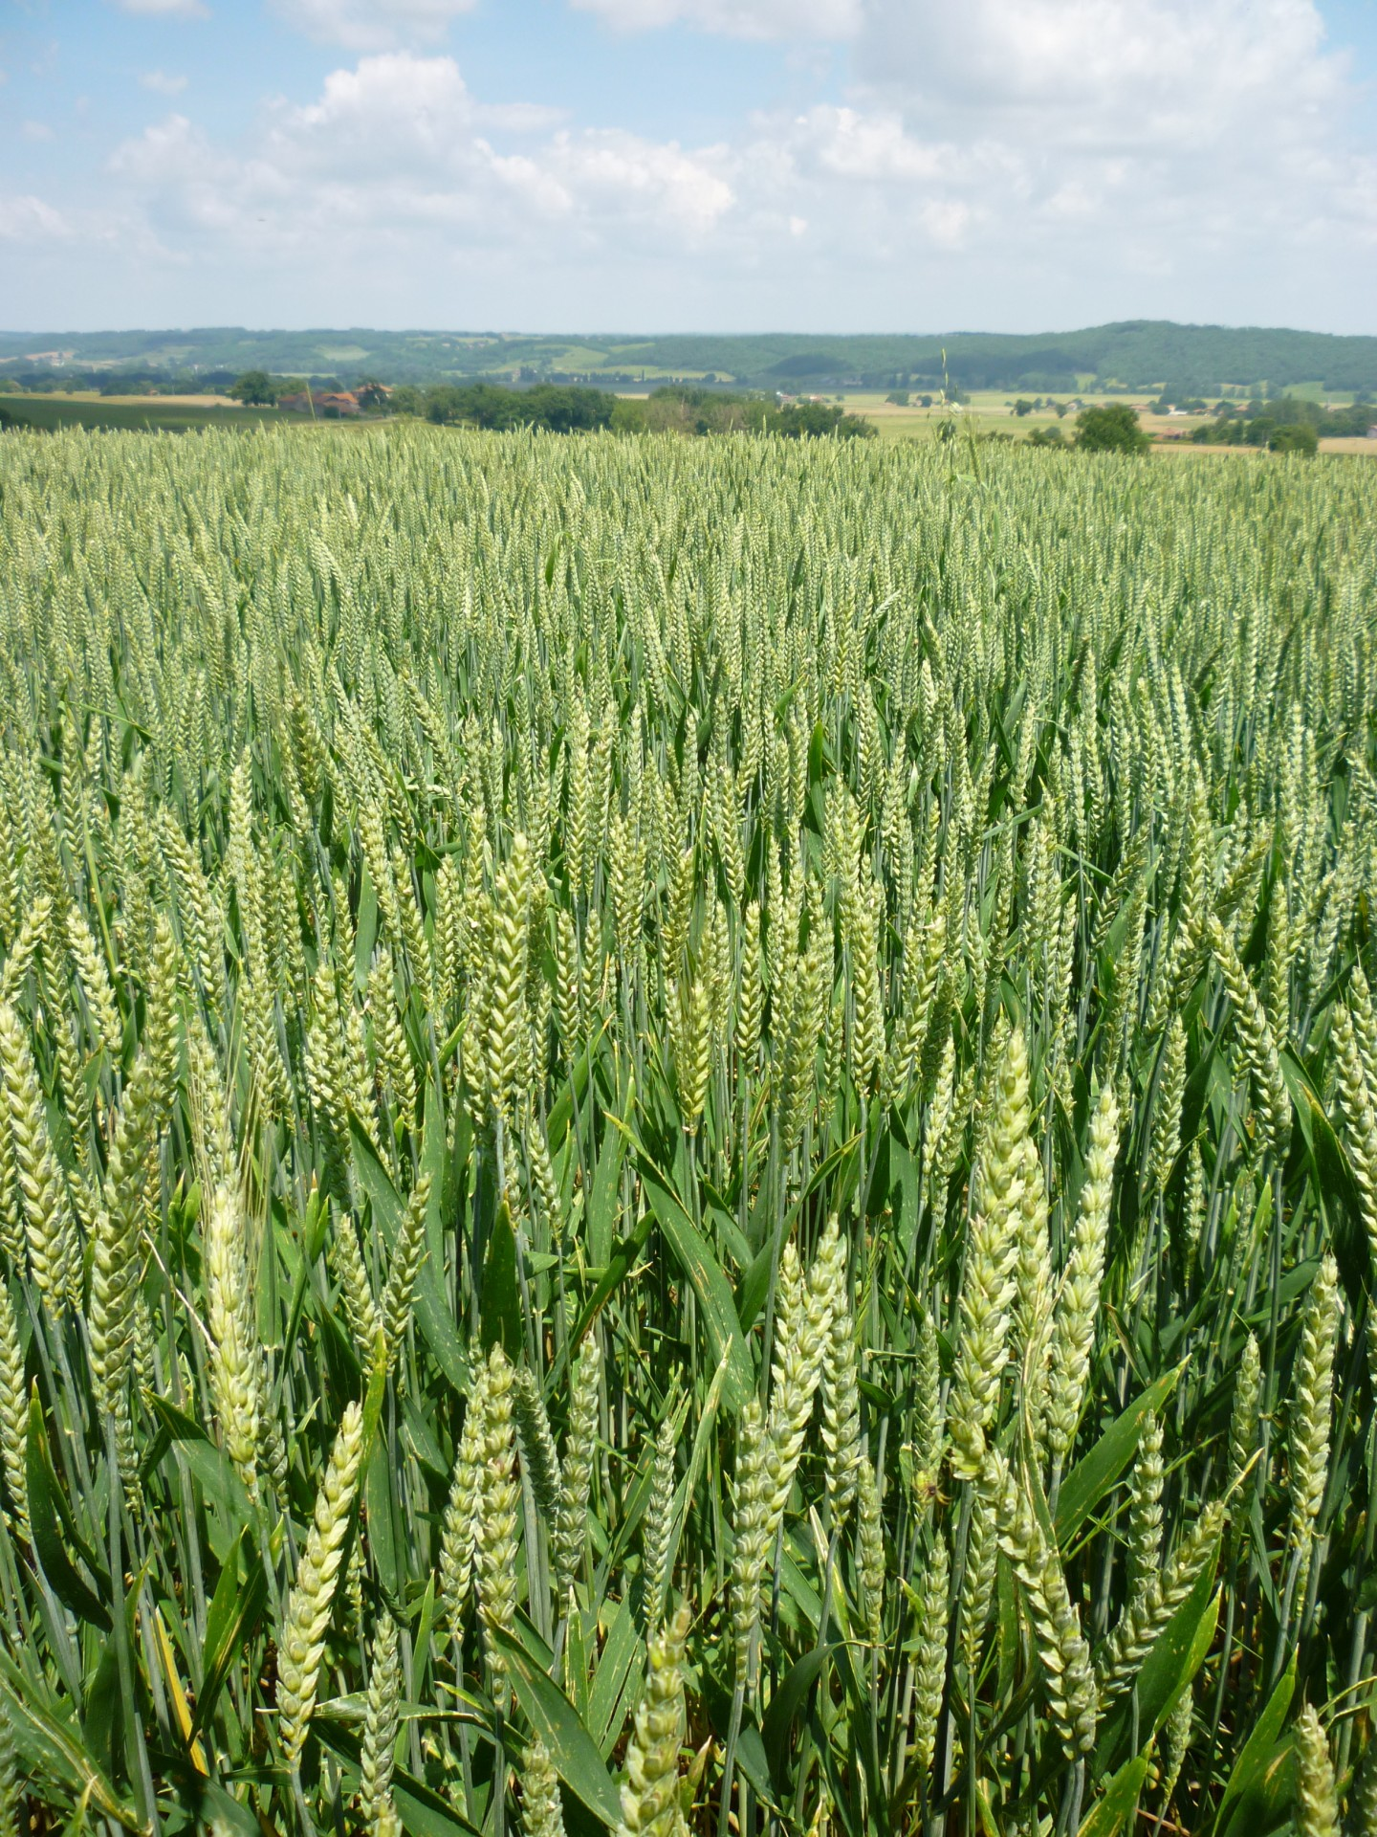
The effects of Water Stress on Crop Yield and Yield Estimation using ML
In this study, we explore the impact of water stress on Wheat yield for Punjab region, using Exploratory Data Analysis in Python. Besides we used Machine Learning to predict yield. We leverage the satellite data from Google Earth Engine as well as wheat yield data for the Punjab region to generate models.

Slide 3
Water Stress and Its Impact on Crop Yield
Introduction:
1
What is Water Stress?
Water stress occurs when plants receive insufficient water due to drought, high temperatures, low soil moisture, or other factors that limit water availability.
How Does Water Stress Affect Crop Yield?
2
Water stress can lead to yield loss in crops, as plants produce smaller fruits, fewer flowers, or lower rates of photosynthesis when faced with water scarcity.
3
How Can We Mitigate Water Stress?
We can improve irrigation techniques as well as schedule the irrigation system by fetching the insights from the satellite data as well as ground IoT based data in order to mitigate water stress, among other strategies.

Slide 4
The Objective of the Study
To Understand Water Stress's Impact on Crop Yield
To Build a Machine Learning Model for Yield Prediction
We seek to understand how water stress affects crop yield using exploratory data analysis in Python. This will help us develop strategies for more sustainable agricultural practices.
We also plan to build a machine learning model to predict crop yield based on satellite data from Google Earth Engine and yield data from the Punjab region. This will help farmers better manage their crops and resources.

Slide 5

Satellite Data from Google Earth Engine and Yield Data of Punjab Region for fetching the insights and building Machine Learning Model to Predict Yield for the Punjab State
We're using satellite data from Google Earth Engine and yield data from the Punjab region to build a machine learning model to predict crop yield in the state of Punjab. This model could be used to help farmers better manage their resources and increase their yields in the future.

Slide 6

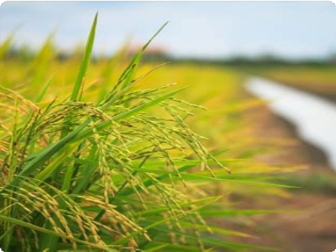

EDA in Python to Analyze How Evapotranspiration Affects Crop Yield
EDA in Python
Evapotranspiration and Crop Yield
Data Analysis to Identify Factors
Exploratory Data Analysis (EDA) is a critical part of machine learning. We're using Python to perform our EDA to analyze how different factors impact crop yield, such as evapotranspiration.
Evapotranspiration is the process where water is transferred from the land to the atmosphere by the combined action of evaporation from the soil and transpiration by plants. We're studying how this process impacts crop yield in different contexts.
We will analyze our initial findings to identify factors that affect crop yield most, such as evapotranspiration rates or soil moisture content, and use them to inform our machine learning model.

Slide 7
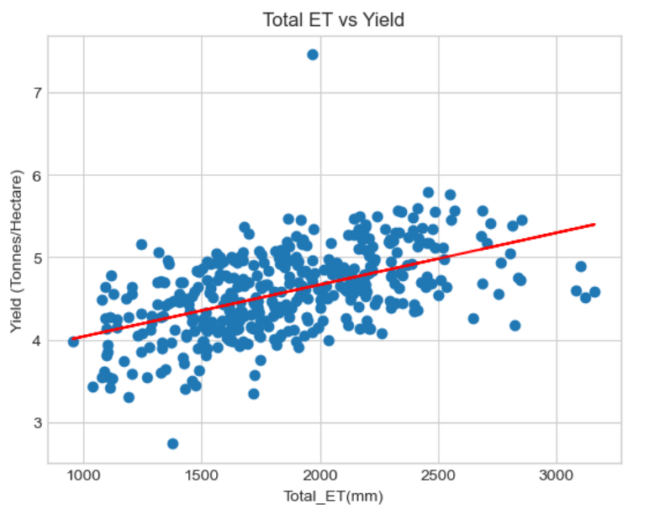
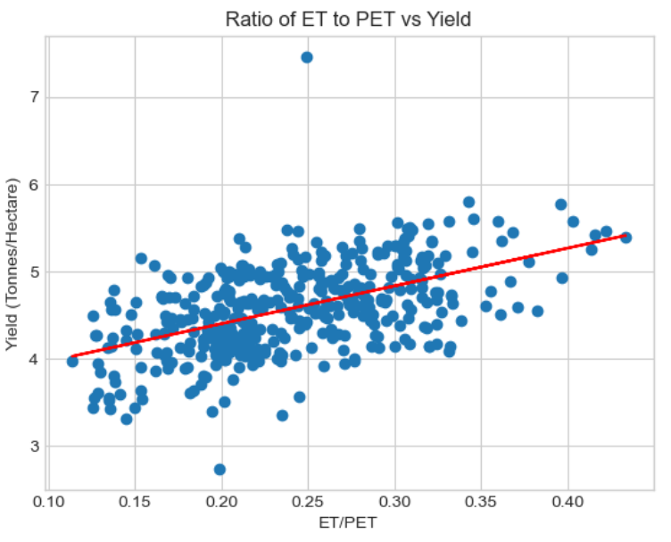
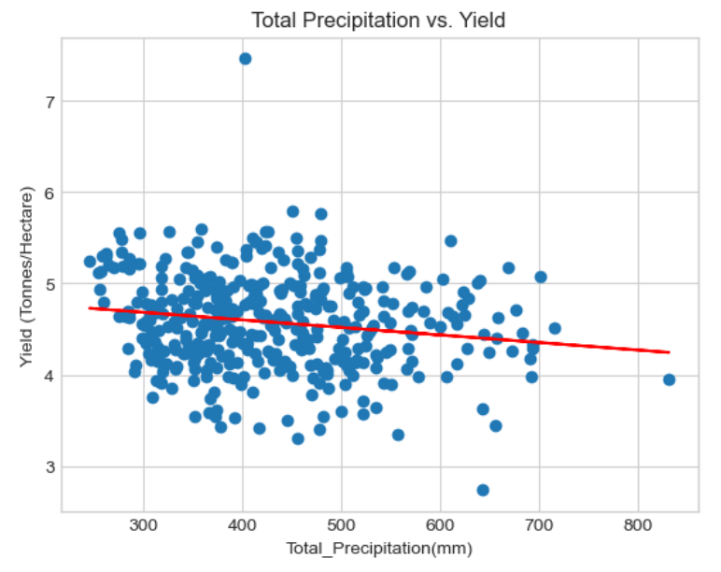
Insights:

Slide 8
ML to Predict Crop Yield
The Power of Machine Learning
The Challenges of Modeling
Machine learning is a powerful tool for predicting outcomes. We're using it to predict crop yield based on satellite data from Google Earth Engine, including temperature, rainfall, NDVI, actual evapotranspiration, potential evapotranspiration, soil moisture.
We must overcome the complexity of predicting crop yield, as many factors impact the final outcome, including weather events, local crop management practices, and the genetics of the plants themselves. We’ve selected the best model and make sure it's accurate across different environments.

Slide 9
Performance Report
Algorithm | R2-Score | MSE
Linear Regression | 0.5120 | 0.1335
Random Forest Regression | 0.5998 | 0.1095
Polynomial Linear Regression | 0.6136 | 0.1057
LGBMRegressor | 0.6632 | 0.0921
XGBRegressor | 0.6726 | 0.0895

Slide 10
Conclusion and Future Steps
Conclusion
Through our project, we found out that the water stress has the significant impact on the crop yield. It is a critical issue that impacts crop yield and food security worldwide. Our research sheds light on the factors that affect crop yield and highlights the importance of using machine learning to make informed predictions.

Slide 11


